Slide 1
Thread New York 2026
Environment reference

Slide 2
The event

Slide 3

The numbers
Thread World Tour
Who came
Thread New York drew retail and ecommerce decision makers to the 101st floor at Hudson Yards for a single day, with morning activations running well before the content program opened.
RSVPs
Customers
419
211
Prospects
Partners
106
32

Slide 4

What Thread is
Thread World Tour
Thread is our conference for conversational commerce, launched in 2022 and kept deliberately small—one day, one room. New York opened the 2026 tour, with London, Los Angeles, and Melbourne to follow.

Slide 5
The space

Slide 6

Hudson Yards
The venue
One floor
Arrival, check-in, and lunch all ran on the 101st floor, and the content program followed in the same room.
Short walks
Morning activations ran in venues across Hudson Yards. Each one sat within a short walk of the main floor.
Three formats
One room carried lunch rounds, a seated stage, and a standing reception, with no room change between them.
A long day
Doors opened at 8:45am, the content program ran from 1:00pm, and the bash closed the night at 8:00pm.

Slide 7
The door
The space
Five shifts
The desk was staffed in five blocks, from 8:45am through to 8:00pm.
Two on deck
Most shifts ran two Attentive hosts alongside Validar support.
Peak cover
The 11:00am to 2:00pm arrival block carried three hosts.
Late cover
One host covered each of the 5:00pm and 6:30pm bash blocks.

Slide 8


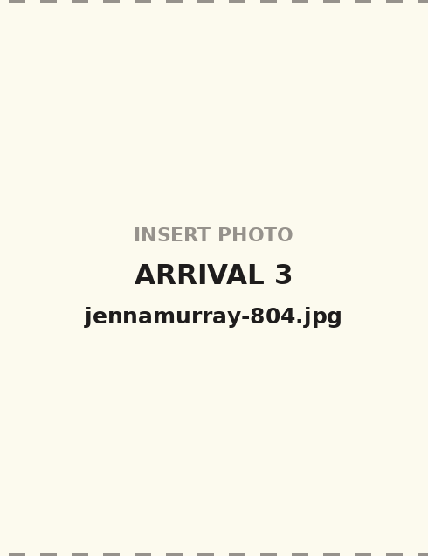
Arrival
The space
Check-in opened at 8:45am
Lunch rounds from 12:00pm
Networking before the program

Slide 9
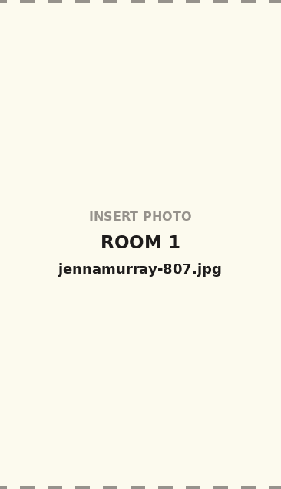



The room
The space
Rounds face the stage
One screen, centered
Clear to the back row
Two networking breaks

Slide 10
The activations

Slide 11
The morning
Activations
SoulCycle
First arrivals rode at 8:15am, well before check-in opened for the main program.
Plaza M
Recharge hosted appointments here for VIP customers through the 9:00am block.
Fellow Barber
Grooming appointments ran alongside the other wellness options that morning.
Sunday Nails
The third wellness and beauty choice offered to VIP customers on arrival.

Slide 12
What's in Store
Activations
Faherty
Ran against the wellness block.
TUMI
One of four store sessions.
All four ran 10:00am to 12:00pm inside Hudson Yards.
Offered to VIP customers registered for Thread.
Guests chose one store session or a wellness slot.
Speakers arrived at 9:45am.
Coach
Bazaarvoice hosted this session.
AG Jeans
A short walk from the main floor.

Slide 13




The evening
Activations
Cocktail hour
Opened at 5:00pm, right after closing remarks.
Food stations
Light bites and stations instead of a seated dinner.
Magnolia Bakery
Treats ran through the cocktail hour and bash.
Thread Bash
The room stayed open until 8:00pm.

Slide 14
Partners
Thread World Tour
Simon Data
Ran a solo session, then joined Attentive and Snowflake on stage, plus a kiosk on the 101st floor.
Bazaarvoice
Hosted the Coach What's in Store session for VIP customers and ran a kiosk in the event space.
Recharge
Hosted Plaza M appointments for VIP customers during the morning block.
Friendbuy
On the partner roster for the New York stop.
Shopify
Rounded out the five partners on site.

Slide 15
What to repeat

Slide 16
One room did all the work.
What to repeat

Slide 17
The shape of the day
Run of show
Morning activations
What's in Store
Arrival and lunch
Content program
Cocktail hour and Bash
SoulCycle first arrivals
Plaza M appointments
Fellow Barber
Sunday Nails
Coach
TUMI
AG Jeans
Faherty
Check-in on the 101st floor
Lunch rounds
Open networking
Welcome and opening remarks
Keynote: market insights
2025 consumer survey
Customer data and personalization
Innovation in Action
Customer spotlight
Future of email
Closing remarks
Light bites and food stations
Magnolia Bakery treats
Open until 8:00pm
8:15am
10:00am
12:00pm
1:00pm
5:00pm
Times reflect the May 20, 2026 run of show.

Slide 18
Three things the next stop should plan for early
What to repeat
One room, one floor
Partners with a job
A morning that earns
Lunch, content, and drinks shared one space.
Guests never relocated mid-day.
One set-up carried three formats.
Each partner had a session, kiosk, or host.
No one was there as signage only.
Five partners, five distinct placements.
Activations pulled VIPs in hours early.
Wellness or retail, the guest chose.
Partners hosted, which shared the load.

